Slide 1
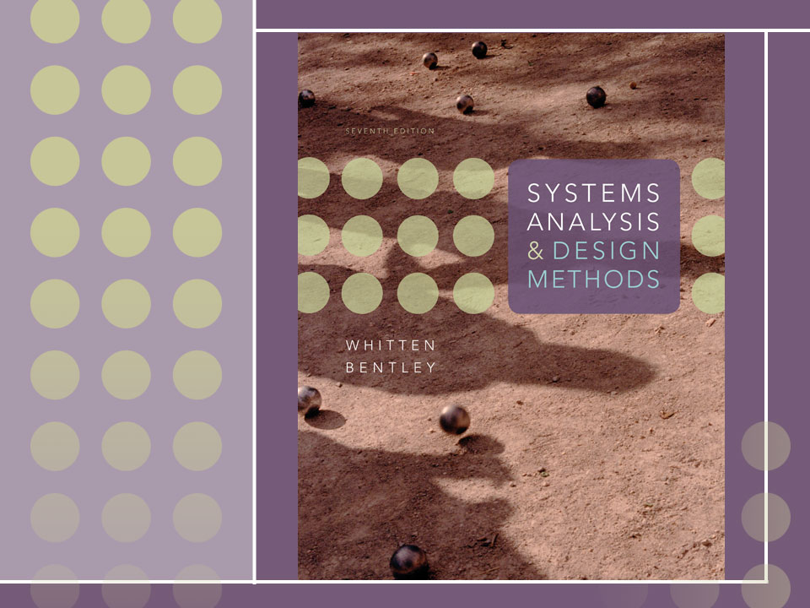
Chapter 13
Application Architecture and Modeling
Notes:
This repository of slides is intended to support the named chapter. The slide repository should be used as follows:
Copy the file to a unique name for your course and unit.
Edit the file by deleting those slides you don’t want to cover, editing other slides as appropriate to your course, and adding slides as desired.
Print the slides to produce transparency masters or print directly to film or present the slides using a computer image projector.
Each slide includes instructor notes. To view those notes in PowerPoint, click-left on the View Menu; then click left on Notes View sub-menu. You may need to scroll down to see the instructor notes.
The instructor notes are also available in hardcopy as the Instructor Guide to Accompany Systems Analysis and Design Methods, 6/ed.

Slide 2
Objectives
Define an information system’s architecture in terms of the KNOWLEDGE, PROCESSES, and COMMUNICATION building blocks.
Differentiate between logical and physical data flow diagrams, and explain how physical data flow diagrams are used to model an information system’s architecture.
Describe centralized and distributed computing alternatives, including client/server and Internet-based computing options.
Describe database and data distribution alternatives for system design.
Describe user and system interface alternatives for system design.
Describe various software development environments for information system design.
Describe strategies for developing or determining architecture of an information system.
Draw physical data flow diagrams for an information system’s architecture and processes.
Notes:
No additional notes.

Slide 3
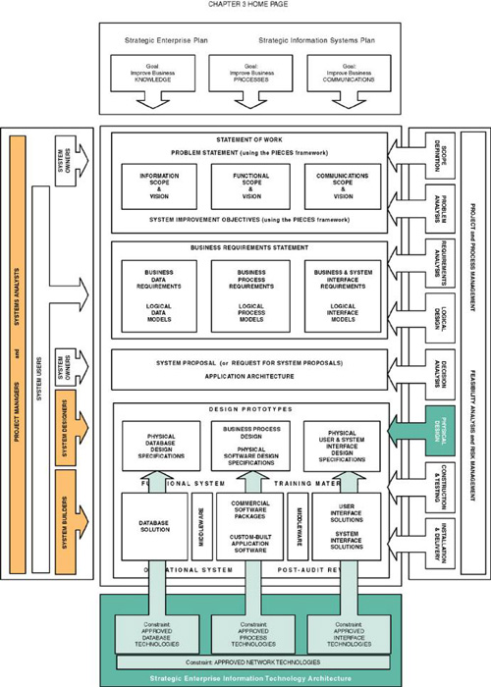
Notes:
Teaching Notes
This slide shows the how this chapter's content fits with the building blocks framework used throughout the textbook. The emphasis of this chapter is with the physical design phase. It spans the communication focus, knowledge focus, and process focus. It involves system designers, system users, and systems analysts working with the organization's strategic enterprise information technology architecture.

Slide 4
Application Architecture
Application architecture – a specification of the technologies to be used to implement information systems. The blueprint to communicate the following design decisions:
  The degree to which the information system will be centralized or distributed.
  The distribution of stored data.
  The implementation technology for software developed in-house.
  The integration of commercial off-the-shelf software.
  The technology to be used to implement the user interface.
  The technology to be used to interface with other systems
Notes:
Teaching Notes
We like to compare an application architecture to a set of construction blueprints that a building contractor might require for different building aspects such as framing, electrical, plumbing, ventilation, etc.

Slide 5
Physical Data Flow Diagram (DFD)
Physical data flow diagram (DFDs) – a process model used to communicate the technical implementation characteristics of an information system.
  Communicate technical choices and other design decisions to those who will actually construct and implement the system.
  Recall from Chapter 9 that DFDs are a type of process model.
Notes:
Teaching Notes
Physical DFDs are part of structured analysis and design.
For some students, a review of Chapter 9 should precede this lesson.
It may be useful to quickly review the slides from Chapter 9 that differentiated between logical and physical modeling.

Slide 6
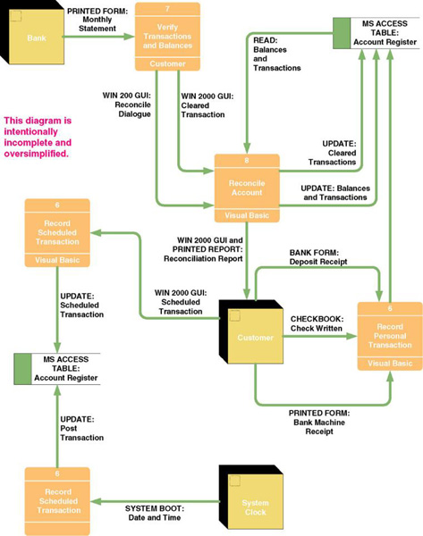
Sample Physical
Data Flow Diagram
Notes:
Teaching Notes
We have found it useful to walk through this first DFD. Don’t be alarmed if students take exception to some of the oversimplification of the illustrated problem—it can actually contribute to the learning experience.

Slide 7
Physical Processes
Physical process – either a processor, such as a computer or person, or a technical implementation of specific work to be performed, such as a computer program or manual process.
  Logical processes may be assigned to physical processors such as PCs, servers, people, or devices in a network. A physical DFD would model that network structure.
  Each logical process requires an implementation as one or more physical processes.
  A logical process may be split into multiple physical processes:
    To define aspects performed by people or computers.
    To define aspects implemented by different technologies.
    To show multiple implementations of the same process.
    To add processes for exceptions and security.
Notes:
Teaching Notes
Some students have difficulty understanding why we might split a logical process into multiple physical processes. It may be useful to walk through this list and give them examples from your own experience or reading.

Slide 8
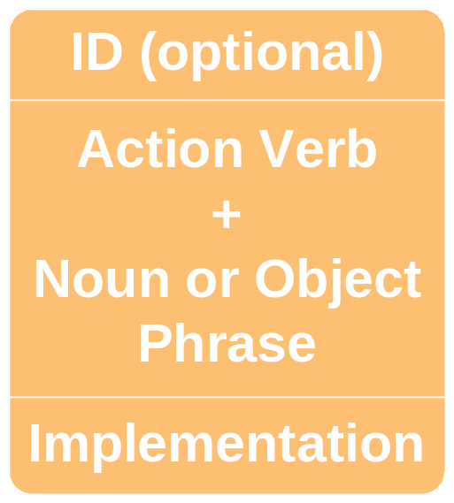
Physical Process Notation
Notes:
Conversion Notes
This is the Gane and Sarson notation. The DeMarco and Yourdon notation does not provide for a separate symbolic differentiation between logical and physical processes.
Depending on your choice of CASE or automated modeling tool, you may need to specify slightly different notations for your students.

Slide 9
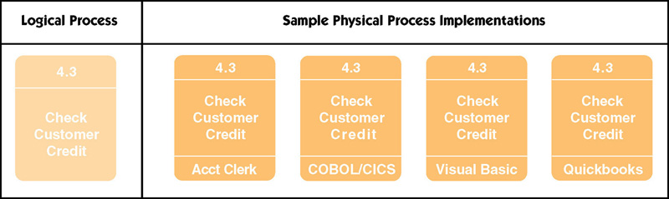
Samples of Physical Processes
Notes:
Teaching Notes
This slide does not illustrate the splitting of a logical process into four physical processes
This slide illustrates four possible implementations of the same logical process

Slide 10
Possible Computer Process Implementations
A purchased application software package
  Also called commercial off-the-shelf (COTS) software
A system or utility program
  Such as an e-mail/message server or third-party framework
An existing application program from a program library
  May require modification
A program to be written
Notes:
No additional notes.

Slide 11
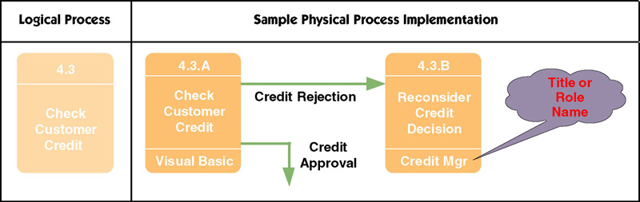
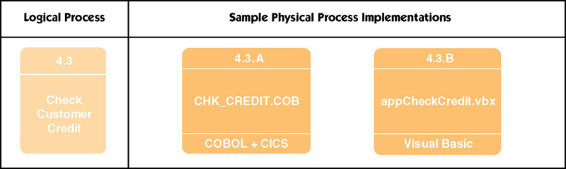
Sample Physical Process Implementations
Notes:
No additional notes.

Slide 12
Physical Data Flows
A physical data flow represents:
  Planned implementation of an input to, or output from a physical process.
  Database command or action such as create, read, update, or delete.
  Import of data from, or
  export of data to another
  information system.
  Flow of data between
  two modules or
  subroutines (represented
  as physical processes).
Implementation method:
Data flow name
OR
Data flow name
(Implementation method)
Notes:
Teaching Notes
The last bulleted item may not be as clear to all students. Many have never used a DFD to factor a program into modules. But most students do appreciate the need to pass parameters, variables, and arguments between modules of a program. Reminding them of this is the first step towards appreciating DFDs as a programming tool.

Slide 13
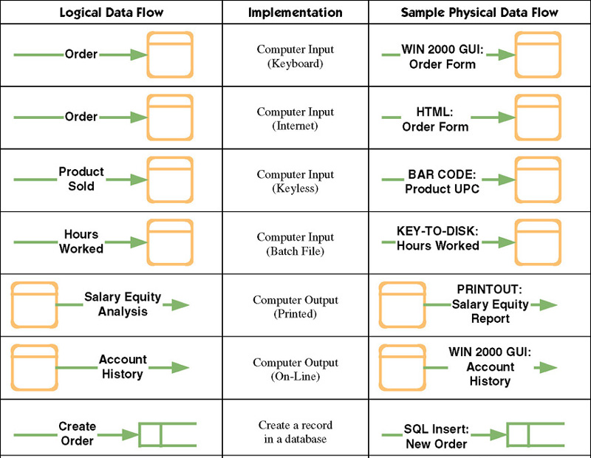
Sample Physical Data Flows
Notes:
Teaching Notes
It may be useful to walk through this table to help students appreciate that there are always alternative physical implementations for any logical data flow.

Slide 14
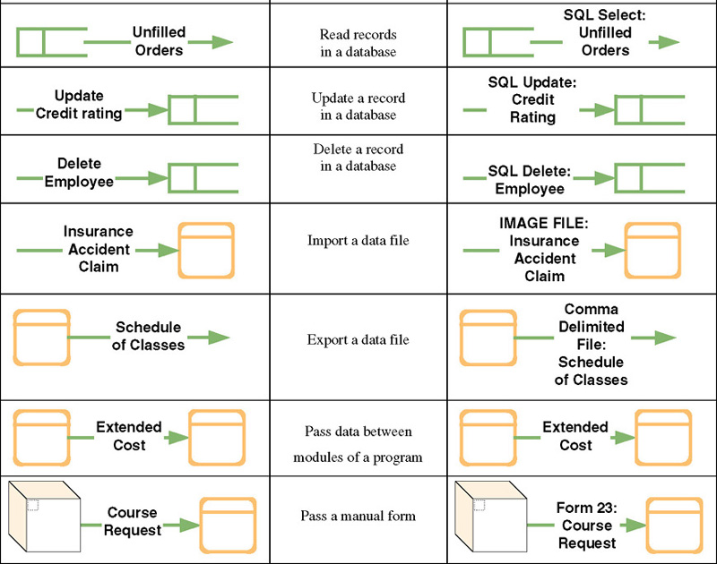
Sample Physical Data Flows (continued)
Notes:
No additional notes.

Slide 15
Physical External Agents
Physical external agents are carried over from the logical DFD models.
  If scope changes, the logical models should be changed before the physical models are drawn.
Notes:
No additional notes.

Slide 16
Physical Data Stores
A physical data store represents the planned implementation of one of:
  A database
  A table in a database
  A computer file
  A tape or media backup of anything important
  A temporary file or batch
  Any type of noncomputerized file
Notes:
No additional notes.

Slide 17
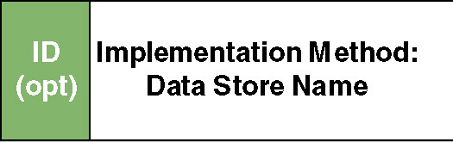
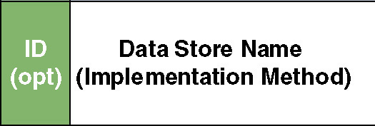
Physical Data Store Notation
Notes:
No additional notes.

Slide 18
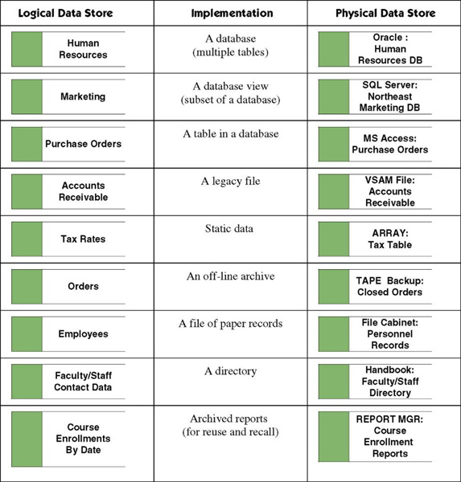
Physical Data Store Implementations
Notes:
Teaching Notes
Again, a walk through of these implementation alternatives can be useful.

Slide 19
Distributed versus Centralized Systems
Distributed system – a system in which components are distributed across multiple locations and computer networks.
  Accordingly, the processing workload is distributed across multiple computers on the network.
Centralized systems – a system in which all components are hosted by a central, multi-user computer.
  Users interact with the system via terminals (or a PC emulating a terminal).
  Virtually all the actual processing and work is done on the host computer.
Notes:
No additional notes.

Slide 20
Why the Trend Toward Distributed Systems?
Modern businesses are already decentralized (distributed).
Distributed computing moves information and services closer to the customers and users who need them.
Distributed computing consolidates the power of personal computers across the enterprise.
Distributed computing solutions are in general more user-friendly because they use the PC as the user interface processor.
Personal computers and network servers are less expensive than mainframe computers
  Though total cost of ownership is at least as expensive
Notes:
Teaching Notes
The last bullet is controversial. Some experts sincerely believe that distributed computing is more costly to maintain. But this belief has not deterred the proliferation of distributed solutions.

Slide 21
Computing Layers
Presentation layer—the user interface
Presentation logic layer—processing that must be done to generate the presentation, such as editing input data or formatting output data.
Application logic layer—the logic and processing to support business rules, policies, and procedures
Data manipulation layer—to store and retrieve data to and from the database
Data layer—the actual business data
Notes:
Conversion Notes
In some books, the presentation and presentation logic layers are combined.

Slide 22
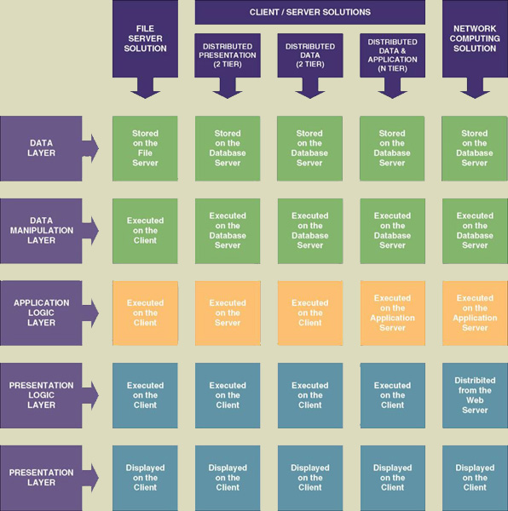
Types of Distributed Computing
Notes:
Teaching Notes
Note the five layers
Note the three basic types of distributes systems architecture (with sub-types):
File server
Client/server
Internet-based
You might want to use this slide twice: first to provide the overview and then later as a review AFTER showing all of the physical DFDs we present for the different flavors.

Slide 23
File Server Architecture
Local area network (LAN) – a set of client computers (PCs) connected over a relatively short distance to one or more servers.
File server system – a LAN in which a server hosts the data of an information system.
  All other layers are implemented on the client computers.
  Frequently excessive network traffic to transport data between servers and clients.
  Client must be fairly robust (“fat”) because it does most of the work.
  Database integrity can be compromised.
Notes:
No additional notes.

Slide 24
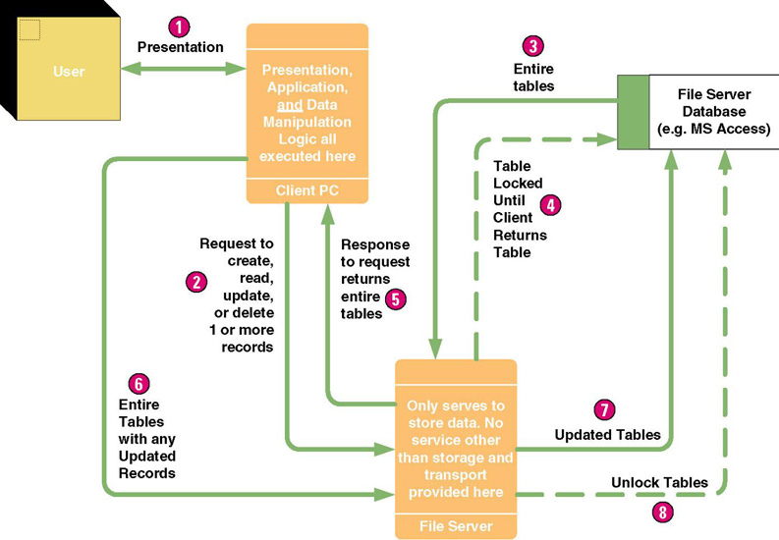
File Server Architecture
Notes:
Teaching Notes
We are constantly amazed at the number of students who think Access applications that store their data on a file server are truly client/server applications (and many books proliferate the misconception). This slide, when contrasted with the client/server equivalent slides, is intended to dispel that myth.
Because the client executes any CREATE, READ, UPDATE, and DELETE commands for a file-server database (such as Access), the entire table must be transported to the client to execute the command. The result is increased data traffic on the network and slow performance.

Slide 25
Client/Server Architecture — Clients
Client/server system – a distributed computing solution in which the presentation, presentation logic, application logic, data manipulation, and data layers are distributed between client PCs and one or more servers.
Thin client – a personal computer that does not have to be very powerful because it only presents the user interface to the user.
Fat client – a personal computer, notebook computer, or workstation that is typically powerful.
Notes:
Teaching Notes
Emphasize that we are not using “fat client” in a negative sense.
For the time being, most knowledge workers will require fat clients for their personal productivity applications (e.g., word processing and spreadsheets), but they may use thin client architecture on those fat clients (e.g., a Web browser or terminal emulator) to run or access remote applications (such as those provided by the information systems unit of the company).

Slide 26
Client/Server Architecture — Servers
Database server – a server that hosts one or more databases and executes all data manipulation commands at the server.
Transaction server – a server that hosts services which ensure that all database updates for a transaction succeed or fail as a whole.
Application server – a server that hosts application logic and services for an information system.
Messaging or groupware server – a server that hosts services for e-mail, calendaring, and other work group functionality.
Web server – a server that hosts Internet or intranet websites.
Notes:
Teaching Notes
The sub-point on database server is to emphasize that we are not talking about a Microsoft Access file server. Only a client/server database management system, such as Oracle, SQL Server, DB2, etc. acts as a database server.
Emphasize that these server categories are not mutually exclusive. For example, many database server and transaction server functions may be integrated on a single physical server. Also, web and messaging server functions are being integrated with each new release of some products.

Slide 27
Client/Server—Distributed Presentation
Distributed presentation – a client/server system in which the presentation and presentation logic layers are shifted from the server to reside on the client.
  The application logic, data manipulation, and data layers remain on the server (frequently a mainframe).
  Character user interface (CUI)
  Graphical user interface (GUI)
Notes:
Teaching Notes
This is sometimes called “the poor man’s client/server.” In reality, the underlying technology allows organizations with constrained resources to give mainframe systems a client/server facelift that extends their useful lifetime until they can be redesigned to more contemporary architectures.

Slide 28
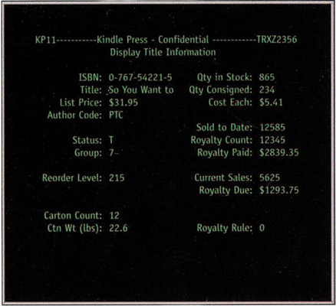
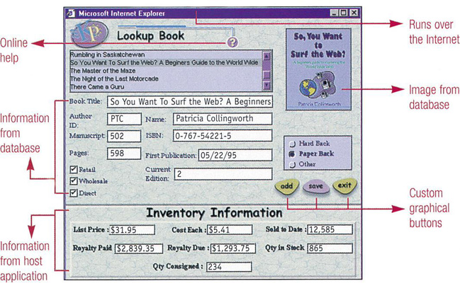
Building a GUI From a CUI – Screen Scrapers
Notes:
No additional notes.

Slide 29
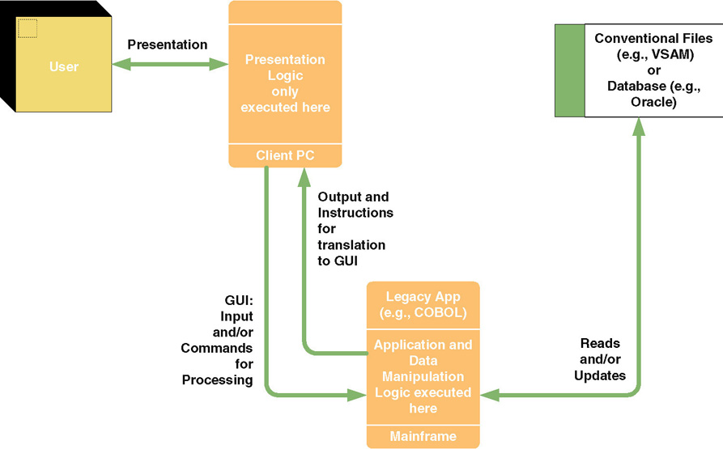
Client/Server—Distributed Presentation
Notes:
No additional notes.

Slide 30
Client/Server—Distributed Data
Distributed data – a client/server system in which the data and data manipulation layers are placed on the server(s), and other layers are placed on the clients.
  Sometimes called two-tiered client/server computing.
  Difference to file server systems is where the data manipulation commands are executed.
  Much less network traffic than file server systems because only the database requests and the results of those requests are transported across the network.
  Database integrity is easier to maintain.
Notes:
Teaching Notes
Tell students that this architecture characterizes most Visual Basic and Powerbuilder applications in existence today.

Slide 31
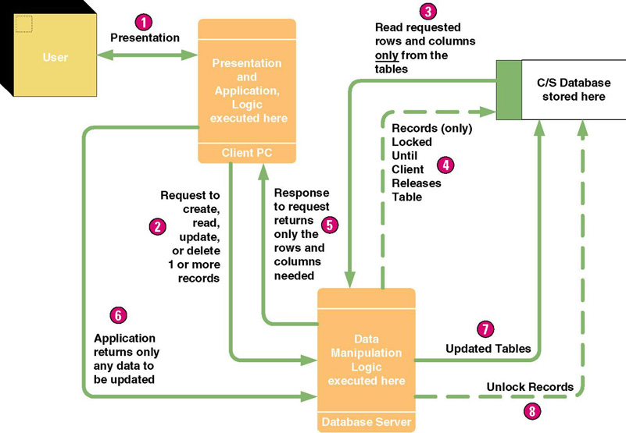
Client/Server—Distributed Data
Notes:
No additional notes.

Slide 32
Client/Server—Distributed Data and Application
Distributed data and application – client/server system:
  The data and data manipulation layers are placed on their own server(s),
  The application logic is placed on its own server,
  The presentation logic and presentation layers are placed on the clients.
  Also called three-tiered or n-tiered client/server computing.
  Requires design partitioning.
Partitioning – the art of determining how to best distribute (duplicate) application components across the network.
Notes:
No additional notes.

Slide 33
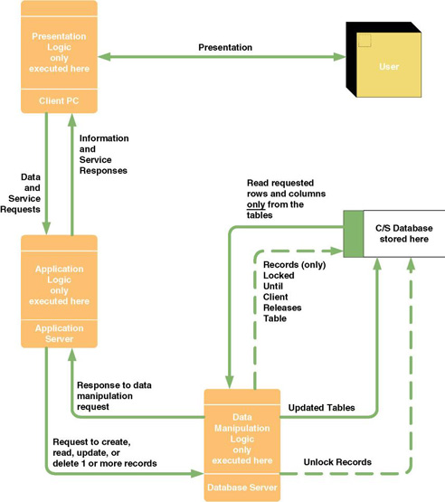
Client/Server — Distributed Data and Application
Notes:
No additional notes.

Slide 34
Internet- and Intranet-based Architectures
Network computing system – presentation and presentation logic layers implemented in client-side Web browsers using content downloaded from a Web server.
  Presentation logic layer connects to application logic layer running on application server, which connects to database servers on the backside of the system.
  The greatest potential of this approach is its applicability to redesign of traditional information systems to run on an intranet.
Intranet – a secure network that uses Internet technology to integrate desktop, work group, and enterprise computing into a cohesive framework.
Notes:
Teaching Notes
Inform students that this is the architecture that is driving e-commerce and e-business.
We expect this architecture to eventually replace most two- and three-tier solutions.

Slide 35
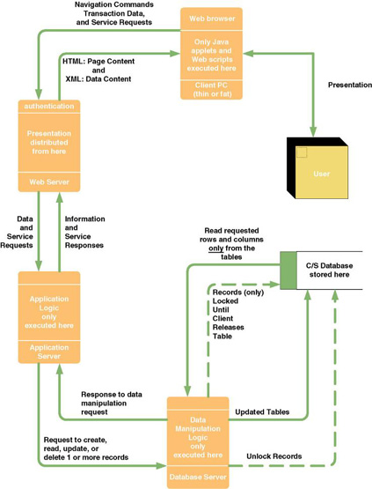
Network Computing System: Internet/Intranet
Notes:
No additional notes.

Slide 36
Internet and Intranet Technologies
Java
  Mostly for programming server-side application logic called “servlets”
  Occasionally for programming client-side application logic called “applets”
HTML (HyperText Markup Language)
  Mostly for programming the presentation layer
XML (Extensible Markup Language)
  Mostly for programming data content to be transported across the web
SQL (Structured Query Language)
  Universal standard language for database manipulation
Web Browsers
Notes:
No additional notes.

Slide 37
Data Architectures
Relational database stores data in tabular form. Each file is implemented as a table. Each field is a column in the table. Related records between two tables are implemented by intentionally duplicated columns in the two tables.
Distributed relational database – A database system that duplicates tables to multiple database servers located in geographically important locations.
Distributed relational database management system – a software program that controls access to and maintenance of stored data in the relational format.
Notes:
No additional notes.

Slide 38
Types of Data(base) Distribution
Data partitioning truly distributes rows and columns of tables to specific database servers with little or no duplication between servers.
  Vertical partitioning assigns different columns to different servers.
  Horizontal partitioning assigns different rows to different servers.
Data replication duplicates some or all tables on more than one database server.
  Propagates updates on one database server to any other database server where the data is duplicated.
Notes:
No additional notes.

Slide 39
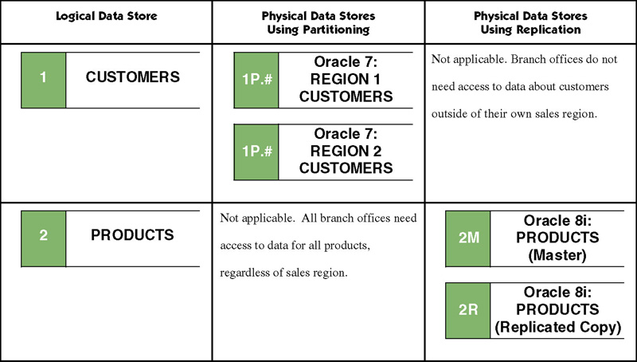
Data Partitioning versus
Data Replication
Notes:
No additional notes.

Slide 40
Interface Architectures – Inputs, Outputs, & Middleware
Batch inputs and outputs
Online inputs and outputs
Remote batch
Keyless data entry (and automatic identification)
Pen input
Electronic messaging and work group technology
Electronic Data Interchange (EDI)
Imaging and document interchange
Middleware
Notes:
No additional notes.

Slide 41
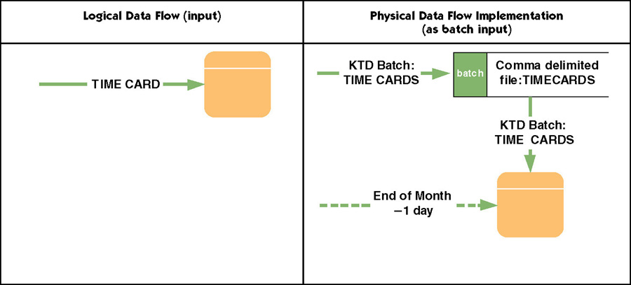
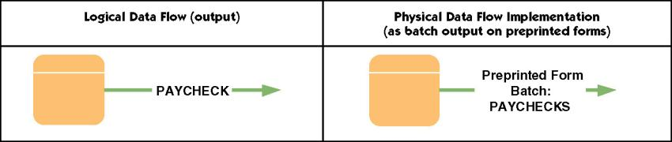
Batch Inputs and Outputs
Notes:
No additional notes.

Slide 42
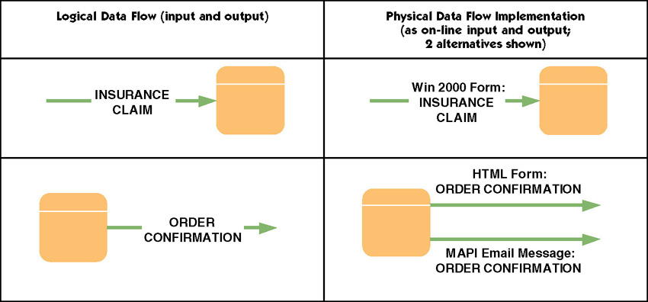
On-Line Inputs and Outputs
Notes:
No additional notes.

Slide 43
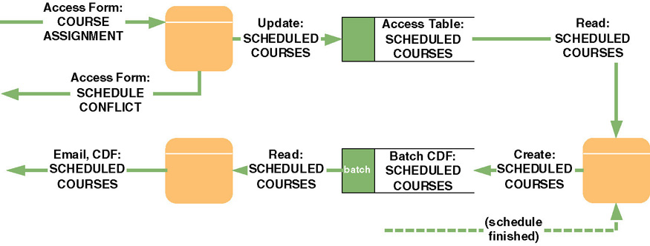
Remote Batch
Notes:
No additional notes.

Slide 44
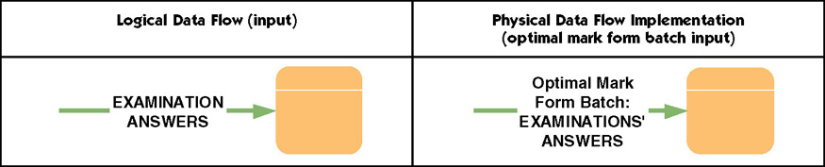
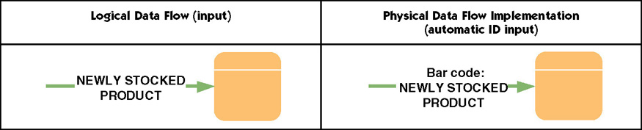
Keyless Data Entry (and Automatic Identification)
Notes:
No additional notes.

Slide 45
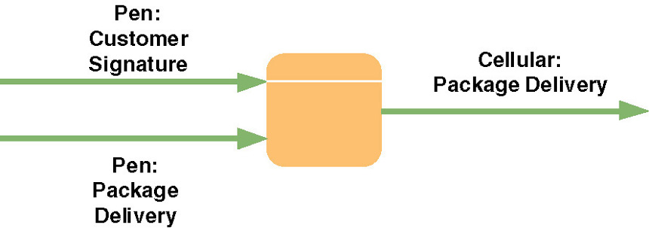
Pen Input
Notes:
No additional notes.

Slide 46
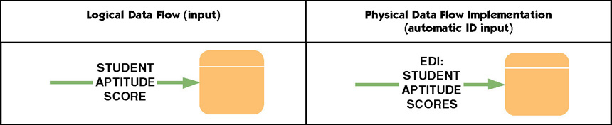
Electronic Data Interchange (EDI)
Electronic Data Interchange (EDI) – the standardized electronic flow of business transactions or data between businesses.
  Typically, many businesses must agree to a common data format to make EDI feasible.
Notes:
No additional notes.

Slide 47
Middleware
Middleware – utility software that enables communication between different processors in a system.
  It may be built into the respective operating systems or added through purchased middleware products.
  Presentation middleware
  Application middleware
  Database middleware
Notes:
Teaching Notes
Some students have probably used database middleware products such as ODBC or JDBC that allow a single application to access and use different vendors’ database engines without having to write a different version of the program for each database engine.

Slide 48
Process Architectures
Software development environment (SDE) – a language and tool kit for developing applications.
  SDEs exist for centralized computing
  SDEs exist for distributed presentation
  SDEs exist for two-tiered client/server
  SDEs exist for multi-tiered client/server
  SDEs exist for Internet and intranet client/server
Clean layering – a design strategy that requires that presentation, application, and data layers of an application be physically separated.
  Allows components of each layer to be revised or enhanced without affecting the other layers.
Notes:
Teaching Notes
Most students have used an SDE without realizing it, Visual Studio for instance. Similarly, Micro Focus COBOL is an SDE for COBOL, and Visual Café’ and J Builder are SDEs for Java.

Slide 49
Application Architecture Strategies for System Design
The Enterprise Application Architecture Strategy
  Enterprise-wide information technology architecture to be followed in all development projects.
    Approved network, data, interface, and processing technologies and development tools.
    Strategy for integrating legacy systems and technologies.
    On-going process for continuously reviewing application architecture.
    On-going process for researching emerging technologies
    Process for analyzing requests for variances from the above.
The Tactical Application Architecture Strategy
  Defines architecture for each new system on an application-by-application basis as needed.
  Requires feasibility analysis for each application.
Notes:
Teaching Notes
Feasibility analysis was covered in Chapter 11.

Slide 50
Drawing Physical DFDs for Network Architecture
Develop a physical data flow diagram (DFD) for the network architecture.
  Each process symbol represents a server or class of clients.
For each processor, develop a physical DFD to show the event processes (from Chapter 9) that are assigned to that processor.
All but simple processes should be factored into design units and modeled as a more detailed physical DFDs.
Notes:
Conversion Notes
Adapted from the former STRADIS and AD/Method methodologies.

Slide 51
Design Units
Design unit – a self-contained collection of processes, data stores, and data flows that share similar design characteristics.
  A design unit serves as a subset of the total system whose inputs, outputs, files and databases, and programs can be designed, constructed, and tested as a self-contained unit.
  Ultimately, design units must be integrated into a whole system.
Notes:
No additional notes.

Slide 52
The Network Architecture DFD
Network architecture – a physical DFD that allocates processors (clients and servers) and devices (machines and robots) to a network and establishes:
  the connectivity between clients and servers
  where users will interface with the processors
Notes:
No additional notes.

Slide 53
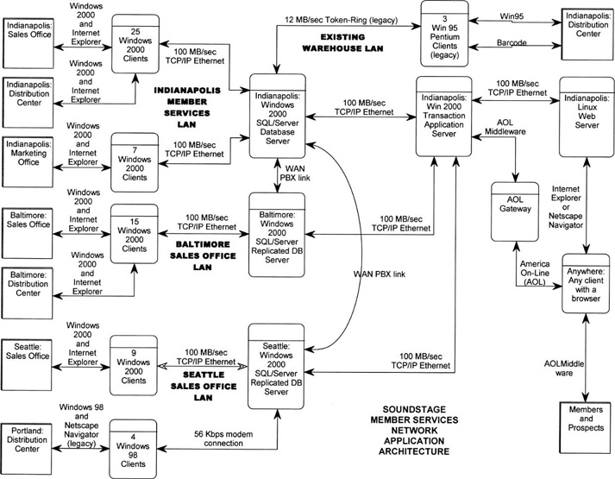
Network Architecture DFD
Notes:
No additional notes.

Slide 54
Data Distribution Options
Store all data on a single server.
Store specific tables on different servers.
Store subsets of specific tables on different servers.
Replicate (duplicate) specific tables or subsets on different servers.
Notes:
No additional notes

Slide 55
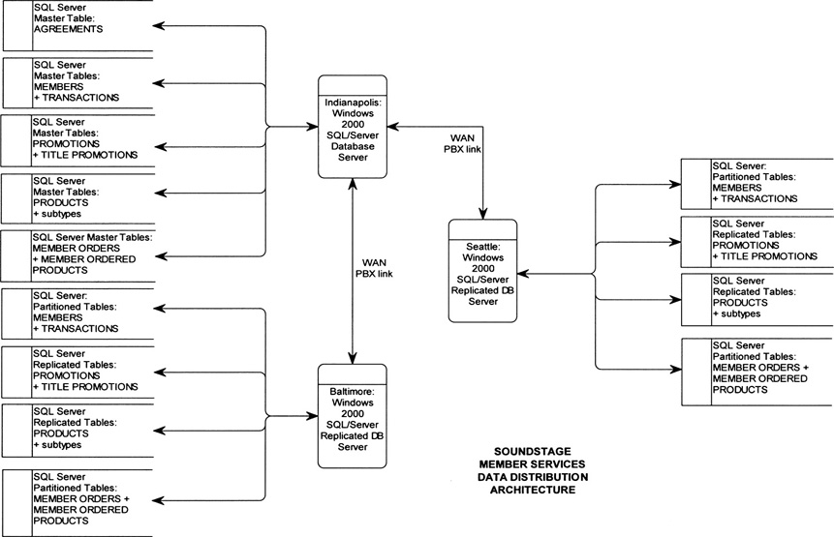
Data Distribution and Technology Assignments DFD
Notes:
No additional notes.

Slide 56
Process Distribution and Technology Assignments
For two-tiered client/server systems, all logical even diagrams are assigned to the client.
For three-tiered client/server and network computing systems, must closely examine each event’s primitive (detailed) DFD.
  Determine which primitive processes should be assigned to the client and which should be assigned to an application server.
  Generally data capture and editing are assigned to servers
  If different aspects of a single DFD are partitioned to different clients and servers, draw separate physical DFD for each.
Notes:
No additional notes.

Slide 57
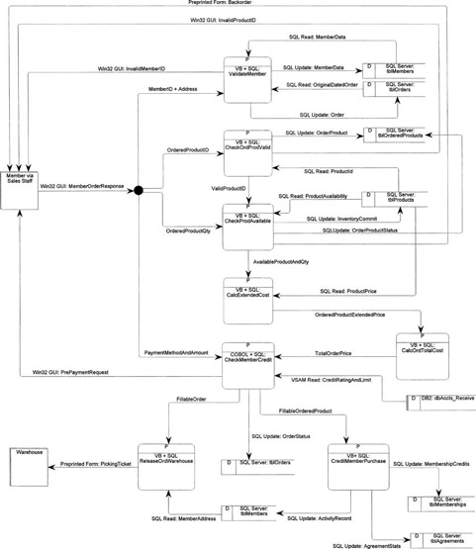
Physical DFD for an Event
See Figure 13-13 in text for a more readable version
Notes:
No additional notes.

Slide 58
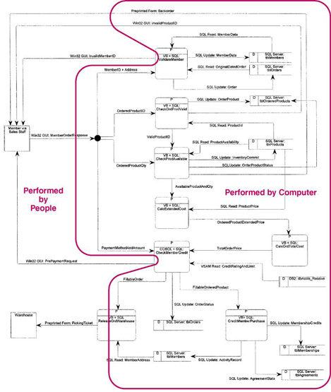
The Person/Machine Boundary
See Figure 13-14 in text for a more readable version
Notes:
No additional notes.

Slide 59
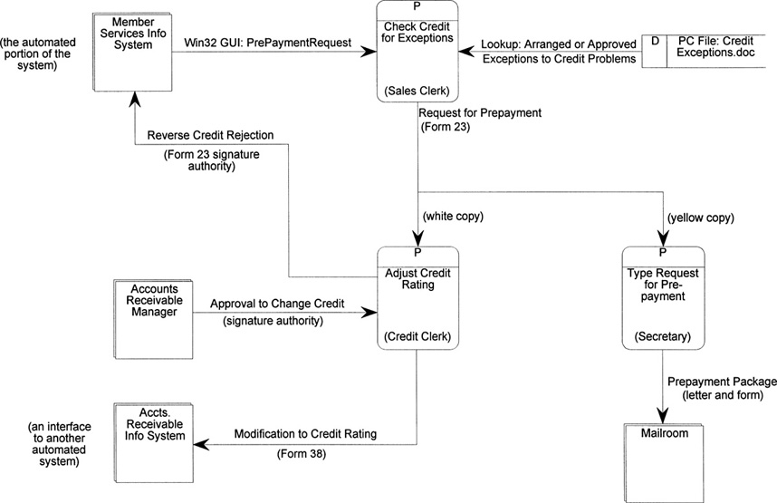
A Manual Design Unit
Notes:
No additional notes.

